Slide 1
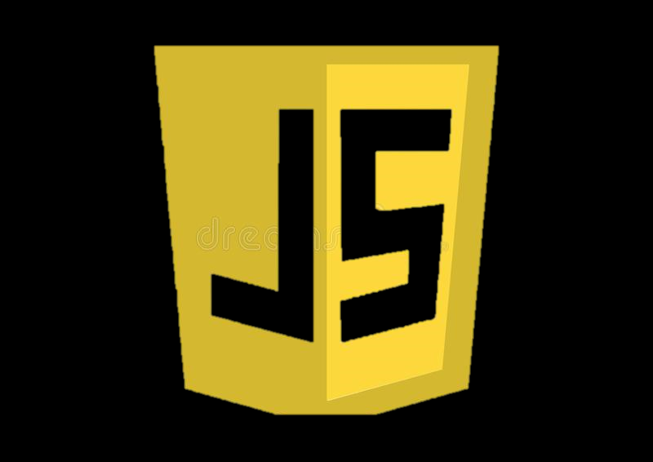
INTRODUCTION TO JAVASCRIPT
Prepared by: Muniba Javaid Khan

Slide 2
OBJECTIVES
Explain scripting
Explain the java script language
Explain client side and server side java script
Explain Java script libraries and frame work

Slide 3
Scripting
Scripting refers to a series of command that are interpreted and executed sequentially and immediately on occurrence of an event.
This event is an action generated by a use while interacting with a web page.
Examples of events include button click, selecting a product from a menu, and so on.
A scripting language refers to set of instruction that provide some functionality when the user interact with a web page.
Scripting language are often embedded in the HTML pages to change the behavior of the web pages.

Slide 4
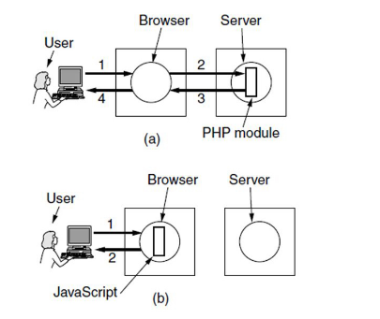
Cont.…
There are two types of scripting language. They are as follow
Client Side Scripting
Server Side Scripting
Client Side Scripting
Refers to a script being executed on the client machine by the browser.
Server Side Scripting
Refer to a script being executed on a web server to generate dynamic HTML pages.

Slide 5
SO WHAT IS JAVASCRIPT
JavaScript is arguably one of the most important languages today.
It is the de facto language of the internet

Slide 6
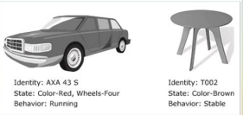
Cont.….
Java script is a scripting language that allows building dynamic web pages by ensuring maximum user interactive.
Java script language is an object based language, which mean that it provides objects for specifying functionalities.
In real world, an object is a visible entity such as car or a table having some characteristics and capable of performing certain actions.
Similarly, in a scripting language an object has a unique identity, state and behavior.
Following figure displays some real world objects

Slide 7
VERSION OF JAVASCRIPT
The first version of java script was developed by Brendan Eich at Netscape in 1995 and was named java script 1.0.
Following table list the various version of java script language.
Version | Description
1.1 | It supported from 3.0 version of the Netscape Navigator and Internet Explorer.
1.2 | It supported the internet explorer from version 4.0
1.3 | It supported the internet explorer from version 5.0.Netscape navigator from version 4.0 and opera from 5.0
1.4 | It is supported by servers of Netscape and opera 6
1.5 | It is supported by servers of Netscape and opera 6.0. Netscape Navigator from version 6.0 and Mozilla Firefox from version 1.0
1.6 | It is supported latest version of the internet explorer and Netscape Navigator browser it is also supported by Mozilla Firefox from version 1.5
1.7 | It is supported in the latest version of internet explorer and Netscape Navigator browser. It is also support by Mozilla Firefox from version 2.0

Slide 8
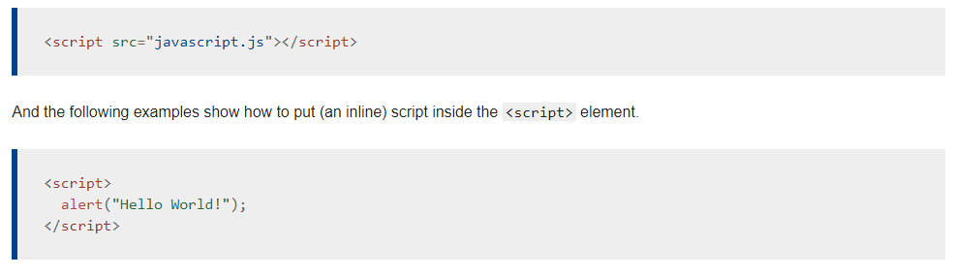
Script tag
The HTML <script> tag is used to define a client-side script (JavaScript).
The <script> element either contains script statements, or it points to an external script file through the src attribute.
Common uses for JavaScript are image manipulation, form validation, and dynamic changes of content.

Slide 9
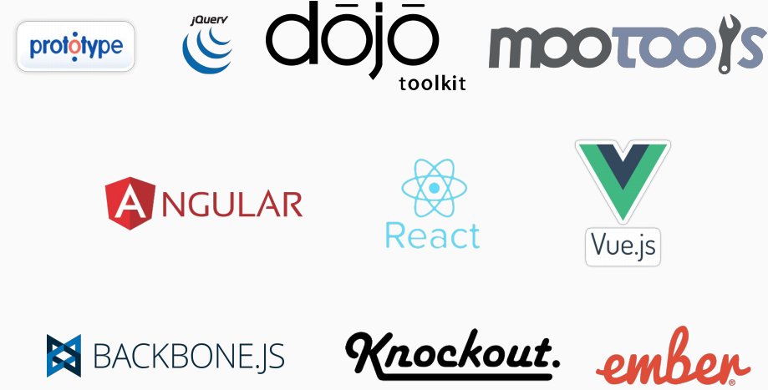
JS LIBRARIES AND FRAMEWORK

Slide 10
Cont.…
In 2004, Google implemented a standardized version of AJAX technology on their Gmail and Google Maps products.
After Ajax JavaScript scene exploded, with new powerful libraries like jQuery which abstracted away browser inconsistencies and made it easier to apply design patterns.
At that time there were lots of effort done by libraries like:
Prototype
jQuery
Dojo
Mootools
And many others
jQuery outshine here and was the most popular JavaScript library for web interfaces

Slide 11
Cont.…
jQuery is cross-platform JavaScript library designed to simplify the client-side scripting. It is free, open-source software.
jQuery is a lightweight, "write less, do more", JavaScript library.
jQuery takes a lot of common tasks that require many lines of JavaScript code to accomplish, and wraps them into methods that you can call with a single line of code.
jQuery made is easier to write JavaScript code once and it will run well on all browsers and version.
jQuery handle that internally
jQuery became fantastically popular due to its ease of use
Ease of use does not necessarily result ease of maintenance.

Slide 13
LET START JAVASCRIPT IMPLEMENTATION
To work with JavaScript you don’t need any software
You just need to have Browser installed on your machine and you can use any text editor to write code.
To manage projects and organize files we use IDE 4. We will use Microsoft’s Visual Studio Code

Slide 14
INSTALLATION
Download and install Visual Studio code
https://code.visualstudio.com/

Slide 15
How to use Visual Studio Code
Open Visual Studio code and create two files
index.html
index.js

Slide 16
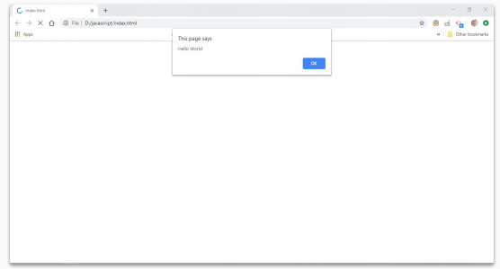
Initial Code and Setup
1. Open file in browser and you will see alert in browser window

Slide 17
ALERTS
An alert is a box that pops up to give the user a message.
Here's code for an alert that displays the message "Thanks for your input!"
alert is a keyword
The quoted text "Thanks for your input!" is called a text string or simply a string.
alert("Hello World");

Slide 18
Cont.…
‘window. Alert’ and ‘alert’ are the same
window is object in browser which contains many other objects and properties, and alert is one of them.
alert is a function that take any input and display it in popup to user
Alerts are not available when you are working with server side JavaScript

Slide 19
CONSOL.LOG
console.log is function that write message on console/terminal
Objective of console.log is to create logs for debugging
Instead of displaying text to user it shows output in browser’s developer tool
Also when working with server side JavaScript, we can use console.log for logging and output will be in terminal.
console.log("Hello World");
console.log(2+8);

Slide 20
DOCUMENT.WRITE
For testing purpose you can use document.write to display message or text in browser window
This will be displayed in browser window
document.write("Hello Word");
document.write(2+8);

Slide 21
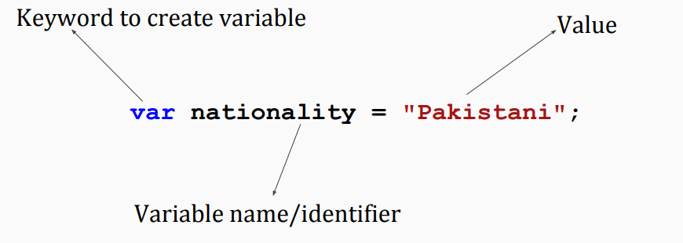
VARIABLES
Variables are containers for storing data values.
Variables are used to store information to be referenced and manipulated in a computer program
Variable is a term that refers to a particular value
A variable changes over time or based on user input.
A variable is assigned a value in one place and then used repetitively

Slide 22
Cont.….
var nationality = "Pakistani";
var age = 25;
var isFeePaid = true;
var weight = 60.55;

Slide 23
DECLERATION AND IN
You can declare and initialize in single line or you can do that in two line
Only declaration will leave variable undefined
var age = 25; OR
var age; -- Declaration
age = 25; -- Initialization

